Slide 1
Welcome, Lovely ACKYA!
Today You Will Need:
A “Key Point” Flyer
A Positive Attitude
Today We Will:
BTSN:
Who is the crazy lady?
Daily Agenda & Social Media
Website Tour
What to do if Absent
Grading
Shameless Begging- Donations ☺
Questions
By the End of Class ACKYA will be able to:
Assist their students in being successful in this class
DUE TODAY:
Show up here ☺
HOMEWORK:
-Visit & bookmark
my website
-Follow me on Twitter and/or Instagram
Please get a BTSN ½ Sheet!

Slide 2
About Kate Collins
Undergrad at University of Washington
Graduate School-M.Ed. From Pepperdine
Post Graduate work at California Lutheran
Professional Clear Single Subject and Career Technical Education Credentials
Taught ages 6-68

Slide 3
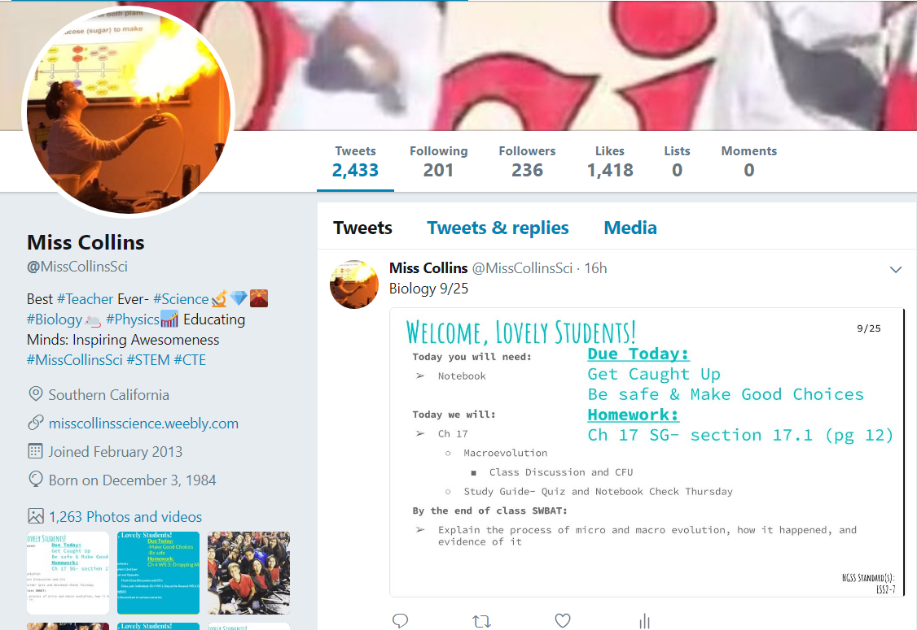
Social Media @MissCollinsSci

Slide 4
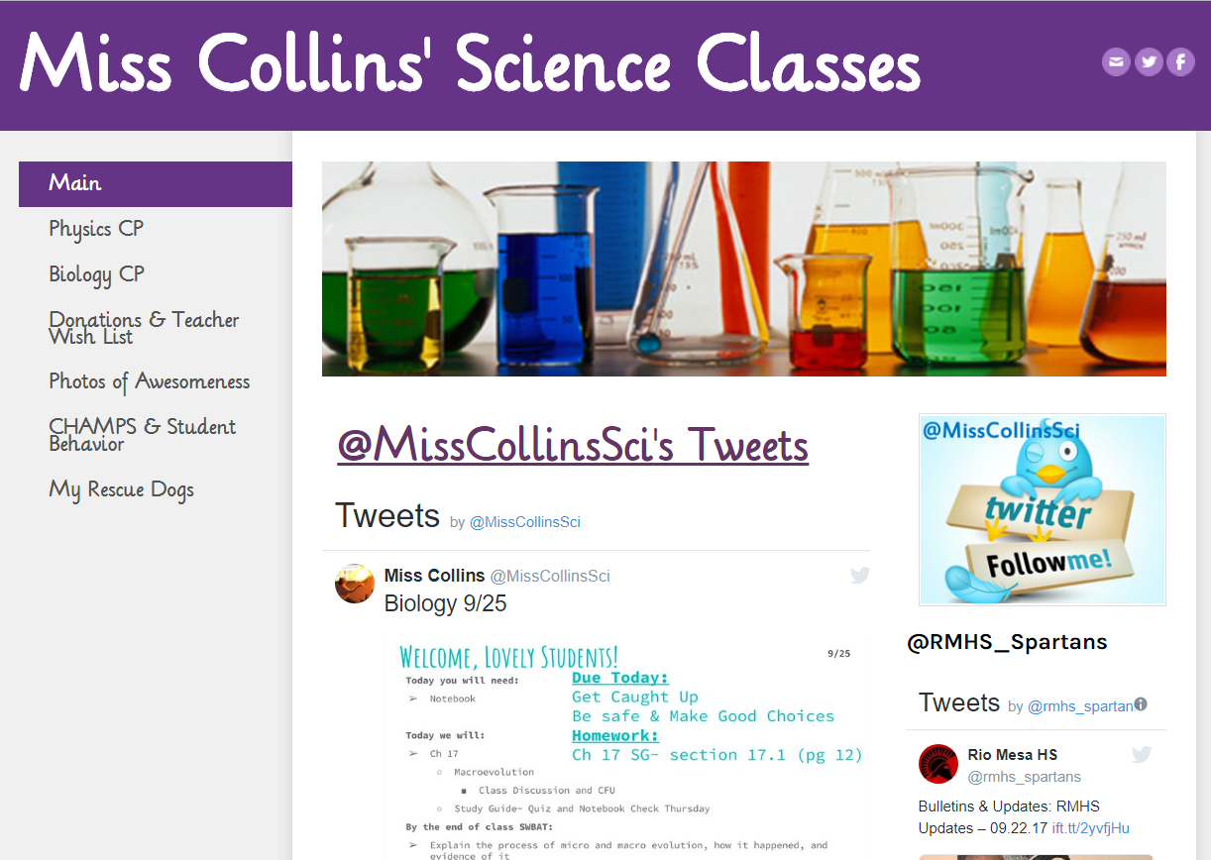
Social Media Icons
Navigation Menu

Slide 5
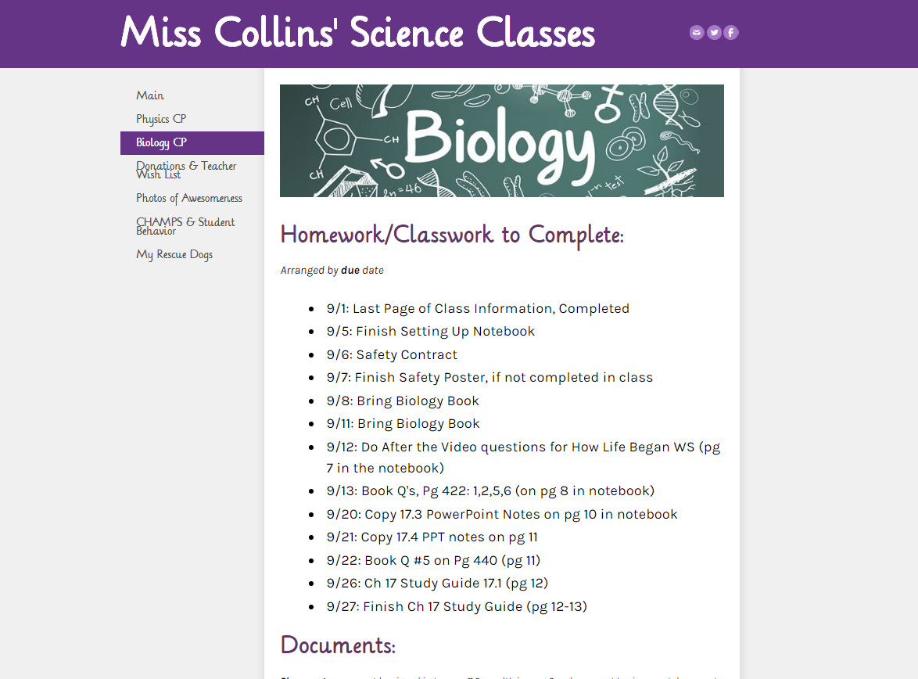
Homework

Slide 6
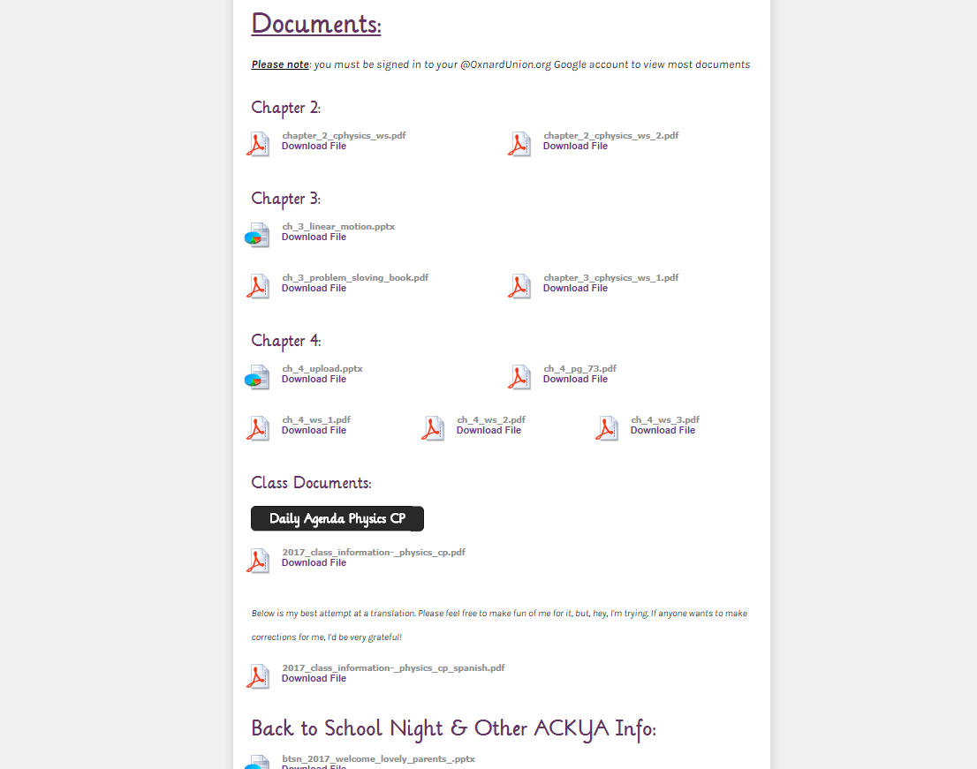
Worksheets
& PPTs
PowerPoints
Files/ PDFs
This PPT

Slide 7
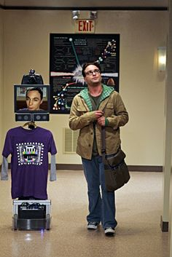
If My Child is Absent:
Check Twitter, Instagram, or website to see what s/he is going to miss & the homework assignment (daily agenda)
Find the work on the website so s/he can start working on it. Download & Print when appropriate
I can accommodate virtual presence
please see me

Slide 8
Grading
No less than 50% on Exams
So…
Pretend the class is out of 100 Points…
The Lowest a student can earn in Exams is 20 points…
And if s/he does most of the homework & classwork…
Let’s say 18/20 in Homework and 38/40 in Classwork
That equals 76/100 or 76%
A passing grade despite failing every exam

Slide 9
Moral of the Story…
Effort is rewarded!
If your child has less than a “C” s/he is not doing classwork/homework completely, correctly, and/or at all.
Students can take pictures of HW avatars to show you

Slide 10
That’s nice, but… What if my kid doesn’t “get it”?
Office Hours!!!
Every school day after school and by appointment

Slide 11
Shameless Begging

Slide 12
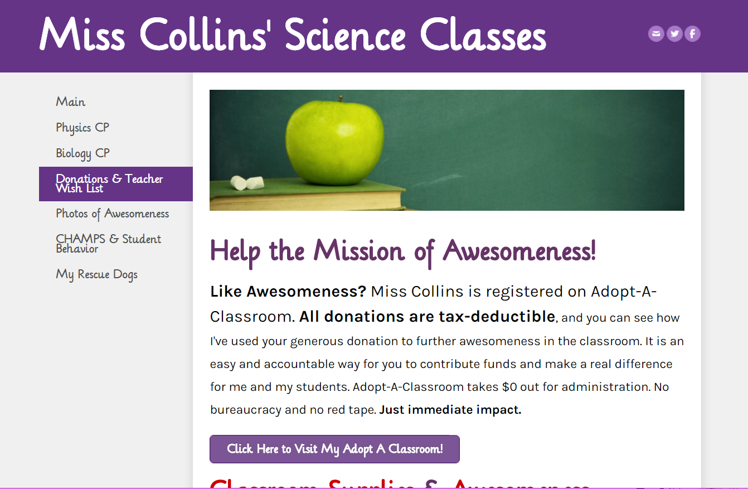
Click here or use the link at the bottom of the flyer
Every little bit HELPS!

Slide 13
I would adore any of the following items:
AAA Batteries
Disinfecting Wipes
New or Gently Used Aquarium Equipment
Garden Equipment
Color Printer Paper
Also, my favorite aquarium supply stores are Doctors Foster & Smith and Vivid Aquariums; I would be very happy to send you a wish list if you would like.
Wish list items on post-its
Please take one on your way out and send the item(s) back with your student
Also, there are really very few things I would ever turn down so if you have any office, school, or science-y things that you would like to donate, but that are not part of my "wish list" above, please bring it in. I am eternally grateful for any and all donations!
Please do not feel obliged to donate anything

Slide 14
Questions

